Slide 1
E1000 network driver
Advanced OS-final presentation
Suwei Yang 2023 Dec 04

Slide 2
Outline
Architecture
Components
Improvement
Result

Slide 3
Architecture
Connect
Write
Read
Client
Server
Write/Read
Socket

Slide 4
Architecture
Connect
Write
Read
Client
Server
Write/Read
Socket
Create files, *f = filealloc()
Create socket, si = (struct sock*)kalloc()
Put socket into file, f->sock = si
Assign file descriptor to file

Slide 5
Architecture
Connect
Write
Read
Client
Server
Write/Read
Socket
Get socket by fd
Allocate 4KB for mbuf
Copyin(mbuf, va)
net_tx_udp()
Fill ip/port info
Get mbuf info
Set mbuf to reg
Command to reg
Push tail to reg

Slide 6
Architecture
Connect
Write
Read
Client
Server
Write/Read
Socket
Sleep if no requirement
Pop mbuf from queue
Copyout(va, mbuf)
mfree

Slide 7
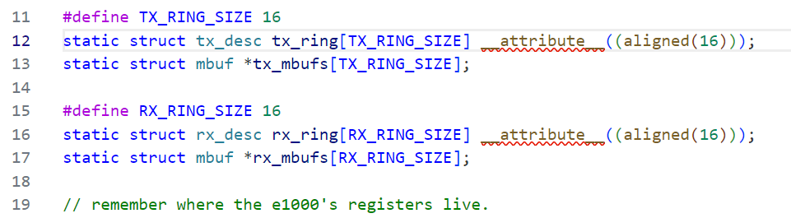
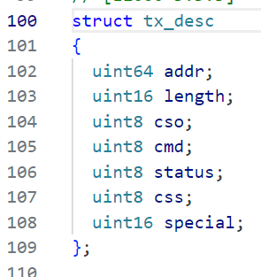
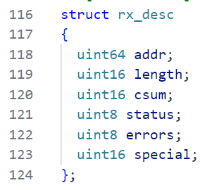
Components
mbuf
rx_mbuf[tail]
Client
Server
Write/Read
mbuf
Socket
tx_desc[tail]
tx_mbuf[tail]
net_rx(m)
Command
tail++
mbuf = allocate(0)
rx_desc[tail] = 0
tail ++

Slide 8
Improvement
mbuf
mbufalloc(mbuf)
copyin(mbuf, addr)
tx_desc[tail]
tx_mbuf[tail]
user
set port/ip/…
return
map mbuf in user space
Command
tail++
user
kernel

Slide 9
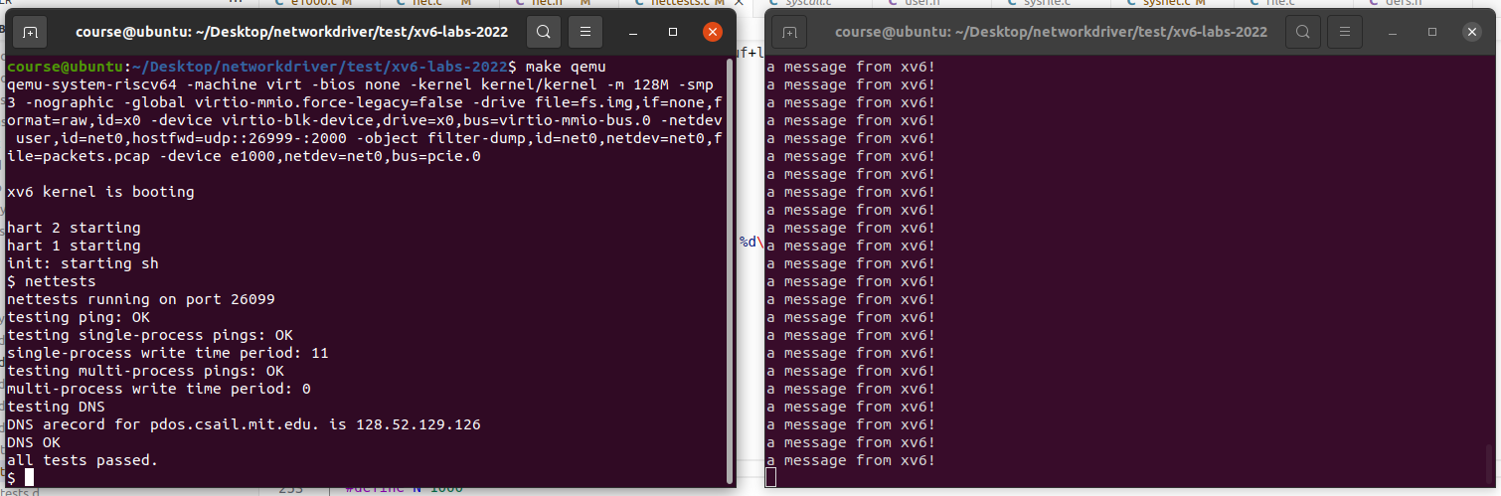
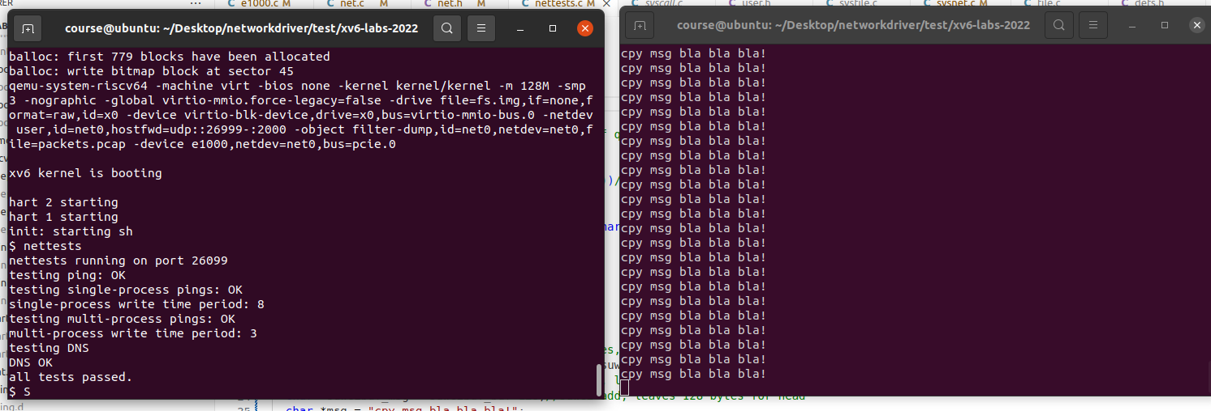
Result
Original
Single process | T1 | T2 | T3 | T4 | T5
Original | 11 | 12 | 13 | 15 | 14
Improvement | 8 | 9 | 15 | 11 | 15
Improvement

Slide 10
Conclusion
Improvement not as significant as I thought
Multi-processes result

